Slide 1
First Trial
Averagin ANN models

Slide 2
Assumptions
A usion selection for the model for each data set
Based on the best model for aggregated the data set
3 approaches:
Average of the Intercepts and the Coefficients for the final model
Weighted average of the Intercepts and the Coefficients based on the number of samples each models is based on
Weighted average of the Intercepts and the Coefficients based on the number of samples each model seen while fitting

Slide 3
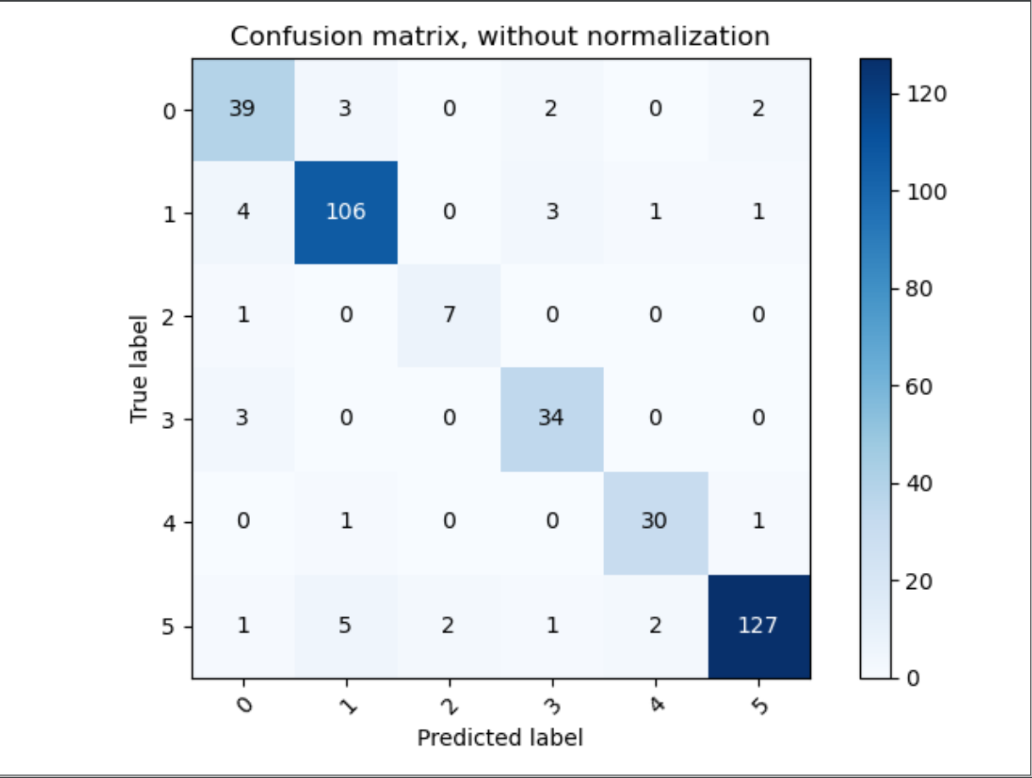
Fitted Model Data Set 1
Accuracy automated: 0.9122340425531915
Precision per class automated: [0.8125 0.92173913 0.77777778 0.85 0.90909091 0.96946565]
Recall per class automated: [0.84782609 0.92173913 0.875 0.91891892 0.9375 0.92028986]
F1-score automated: [0.82978723 0.92173913 0.82352941 0.88311688 0.92307692 0.94423792]

Slide 4
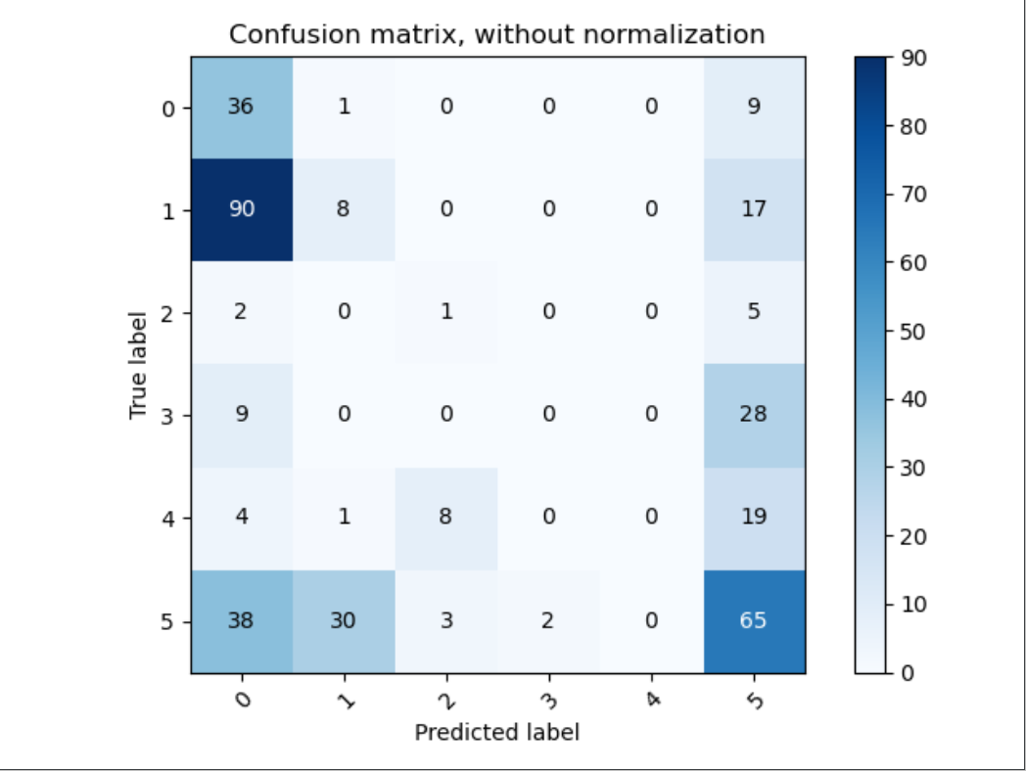
Fitted Model Data Average Set 1
Accuracy automated: 0.2925531914893617
Precision per class automated: [0.20111732 0.2 0.08333333 0. 0. 0.45454545]
Recall per class automated: [0.7826087 0.06956522 0.125 0. 0. 0.47101449]
F1-score automated: [0.32 0.10322581 0.1 0. 0. 0.46263345]

Slide 5
Fitted Model Weighted Average Data Set 1
Accuracy automated: 0.7925531914893617 Precision per class automated: [0.4516129 0.87179487 0.6 0.82142857 0.9375 0.97029703]
Recall per class automated: [0.91304348 0.88695652 0.375 0.62162162 0.9375 0.71014493]
F1-score automated: [0.60431655 0.87931034 0.46153846 0.70769231 0.9375 0.82008368]

Slide 6
Fitted Model Weighted Average (seen samples) Data Set 1
Accuracy automated: 0.8085106382978723
Precision per class automated: [0.47191011 0.88034188 0.66666667 0.83870968 0.90625 0.99009901]
Recall per class automated: [0.91304348 0.89565217 0.5 0.7027027 0.90625 0.72463768]
F1-score automated: [0.62222222 0.88793103 0.57142857 0.76470588 0.90625 0.83682008]

Slide 7
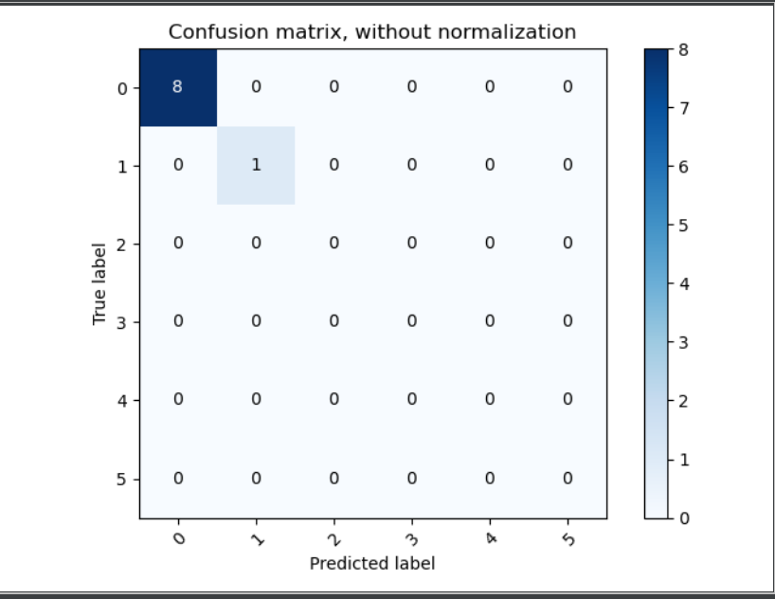
Fitted Model Data Set 2
Accuracy automated: 1.0
Precision per class automated: [1. 1. 0. 0. 0. 0.]
Recall per class automated: [1. 1. 0. 0. 0. 0.]
F1-score automated: [1. 1. 0. 0. 0. 0.]

Slide 8
Fitted Model Average Data Set 2
Accuracy automated: 0.7777777777777778 Precision per class automated: [1. 0. 0. 0. 0. 0.]
Recall per class automated: [0.875 0. 0. 0. 0. 0. ]
F1-score automated: [0.93333333 0. 0. 0. 0. 0. ]

Slide 9
Fitted Model Weighted Average Data Set 2
Accuracy automated: 0.7777777777777778
Accuracy manually: 0.7777777777777778
Precision per class automated: [1. 0. 0. 0. 0. 0.]
Recall per class automated: [0.875 0. 0. 0. 0. 0. ]
F1-score automated: [0.93333333 0. 0. 0. 0. 0. ]

Slide 10
Fitted Model Weighted Average (seen samples) Data Set 2
Accuracy automated: 0.7777777777777778
Precision per class automated: [1. 0. 0. 0. 0. 0.]
Recall per class automated: [0.875 0. 0. 0. 0. 0. ]
F1-score automated: [0.93333333 0. 0. 0. 0. 0. ]

Slide 11
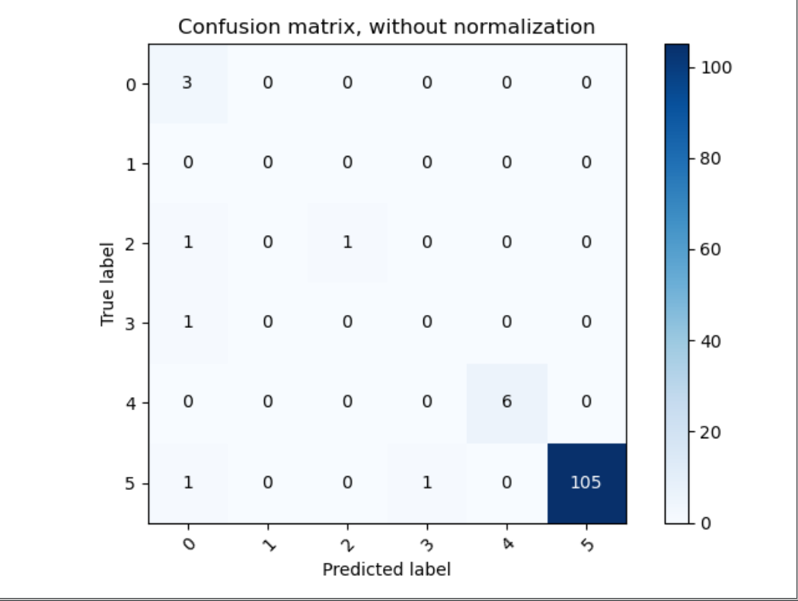
Fitted Model Data Set 3
Accuracy automated: 0.9663865546218487
Precision per class automated: [0.5 0. 1. 0. 1. 1. ]
Recall per class automated: [1. 0. 0.5 0. 1. 0.98130841]
F1-score automated: [0.66666667 0. 0.66666667 0. 1. 0.99056604]

Slide 12
Fitted Model Average Data Set 3
Accuracy automated: 0.4117647058823529 Precision per class automated: [0.04651163 0. 0. 0. 1. 0.93617021]
Recall per class automated: [0.66666667 0. 0. 0. 0.5 0.41121495]
F1-score automated: [0.08695652 0. 0. 0. 0.66666667 0.57142857]

Slide 13
Fitted Model Weighted Average Data Set 3
Accuracy automated: 0.2689075630252101 Precision per class automated: [0.03125 0. 0. 0. 0.54545455 1. ]
Recall per class automated: [0.33333333 0. 0. 0. 1. 0.23364486]
F1-score automated: [0.05714286 0. 0. 0. 0.70588235 0.37878788]

Slide 14
Fitted Model Weighted Average (seen samples) Data Set 2
Accuracy automated: 0.2605042016806723
Precision per class automated: [0. 0. 0. 0. 0.54545455 1. ]
Recall per class automated: [0. 0. 0. 0. 1. 0.23364486]
F1-score automated: [0. 0. 0. 0. 0.70588235 0.37878788]

